Slide 1
Streaming Demo

Slide 2
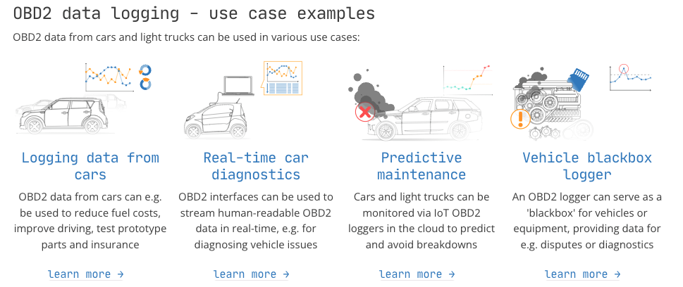
Streaming data: The Story
Any kind of data is produced as a stream of events.
Credit card transactions, sensor measurements, machine logs, or user interactions on a website or mobile application, all of these data are generated as a stream.
In our use case …..
Notes:
Example description:
In this demo we are showing car sensor data (OBD2) from edge to determine location, looking up the location from a geo locations table, find the weather condition at that location, and visualize the weather conditions in a map by location. We use MiNiFi to gather the edge data, send to Kafka, Flink and SQL Stream Builder to do continuous processing of the stream from Kafka and join with geo location data from a Kudu table, store the join in another Kudu table, and use Data Vis to visualize the weather location data.

Slide 3
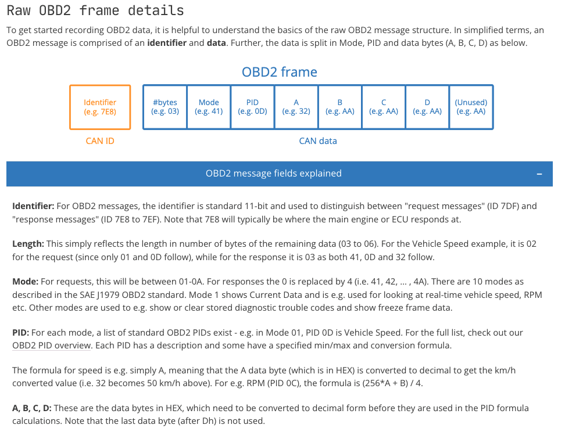
DRAFT / WIP
Useful data
Need useful / proper data …
Let’s use OBD2
Link

Slide 4
Streaming Data Scenario: Zero Downtime
IoT for predictive maintenance
DATA ENGINEERING
OPERATIONAL DATABASE
Collect
Report
Predict
02
04
01
03
05
Enrich
Serve
STREAMING & DATA FLOW
DATA WAREHOUSE
MACHINE LEARNING & AI

Slide 5





DEMO FLOW
Virtual Table: iot_enriched_source
topic: iot
JSON message > append only
JOIN
Data Visualization
Virtual Table: weather_condition_upsert
topic: kafka_LookupWeatherCondition
CSV message
> update / Key: StationId
Virtual Table: refdata_geolocation
Kudu table: RefData_GeoLocation
Kudu table: sensors_joined
Virtual Table: sensors_joined

Slide 6
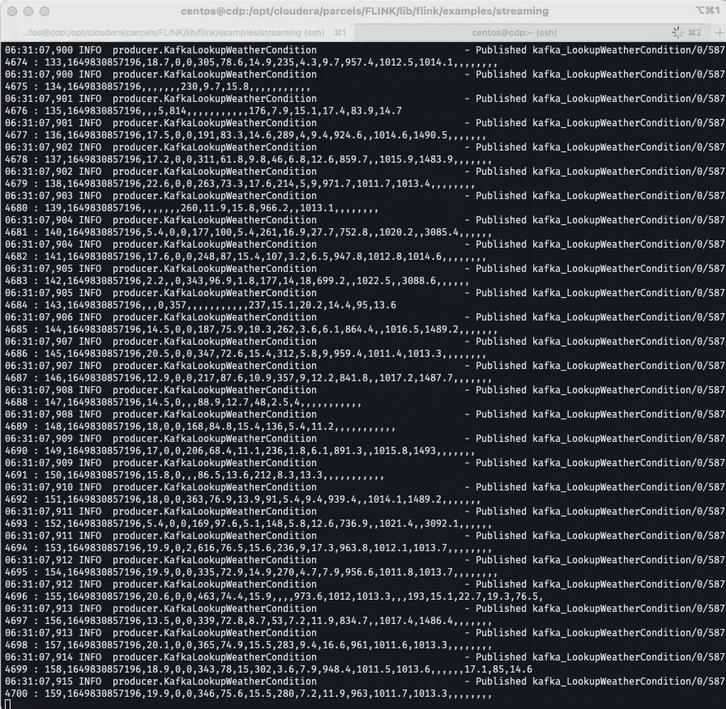

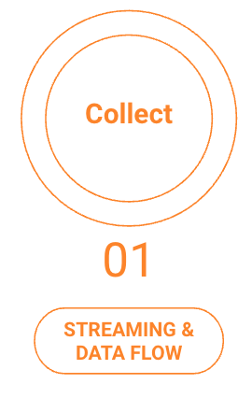







Collection Phase
Collect data from the edge

Slide 7
Kafka Inputs
- Published iot/8/8469 : {"sensor_ts":1649831184077,"truck_id":12,"sensor_0":351,"sensor_1":5,"sensor_2":14,"sensor_3":12,"sensor_4":22,"sensor_5":17,"sensor_6":61,"sensor_7":66,"sensor_8":78,"sensor_9":17,"sensor_10":308,"sensor_11":708}
- Published kafka_LookupWeatherCondition/12/5843963 : 109,1649830857196,15.7,0,0,318,94.5,14.8,176,3.2,6.1,919.4,,1015.3,1490.8,,,,,,,
Notes:
Rename the JSON parts
Fuel level/miles/temperature/

Slide 8
Enrich the data
DATA ENGINEERING
02
Enrich

Slide 9
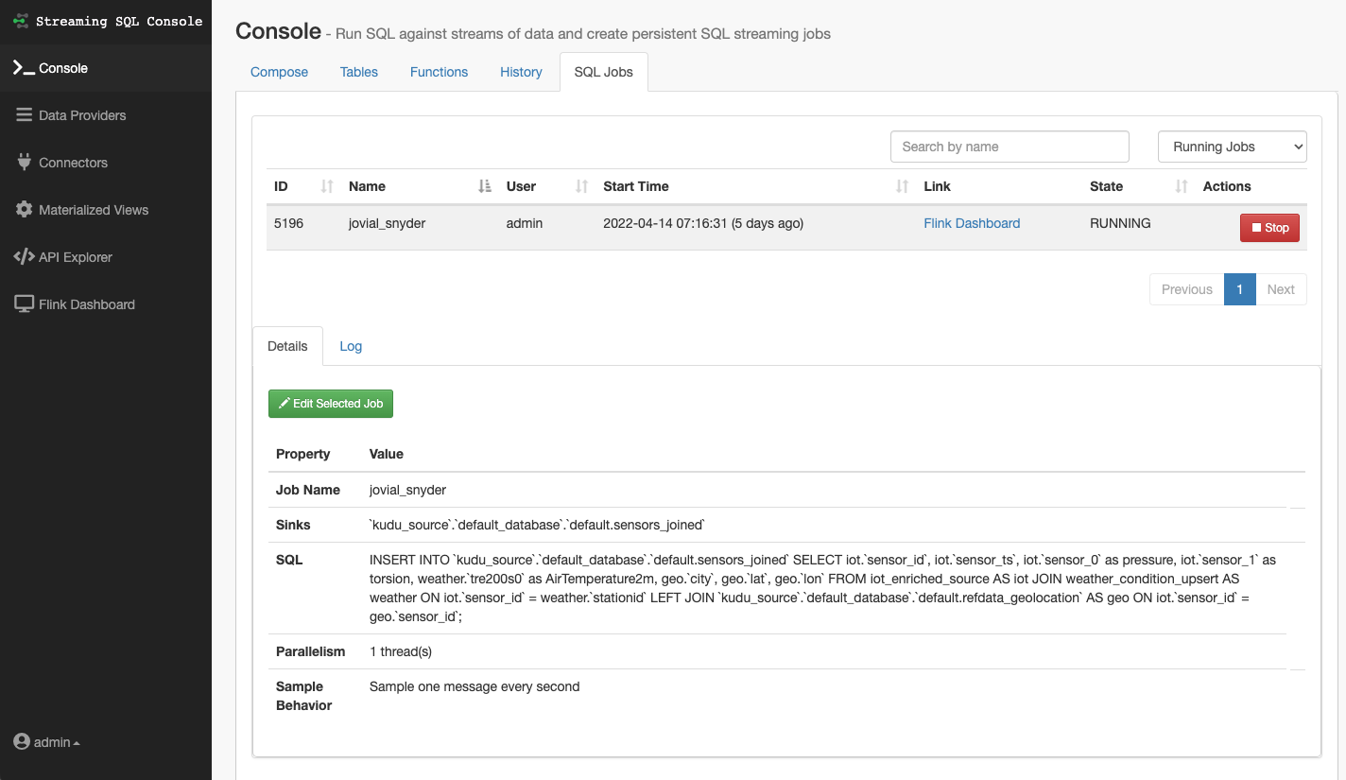
SSB
Link

Slide 10
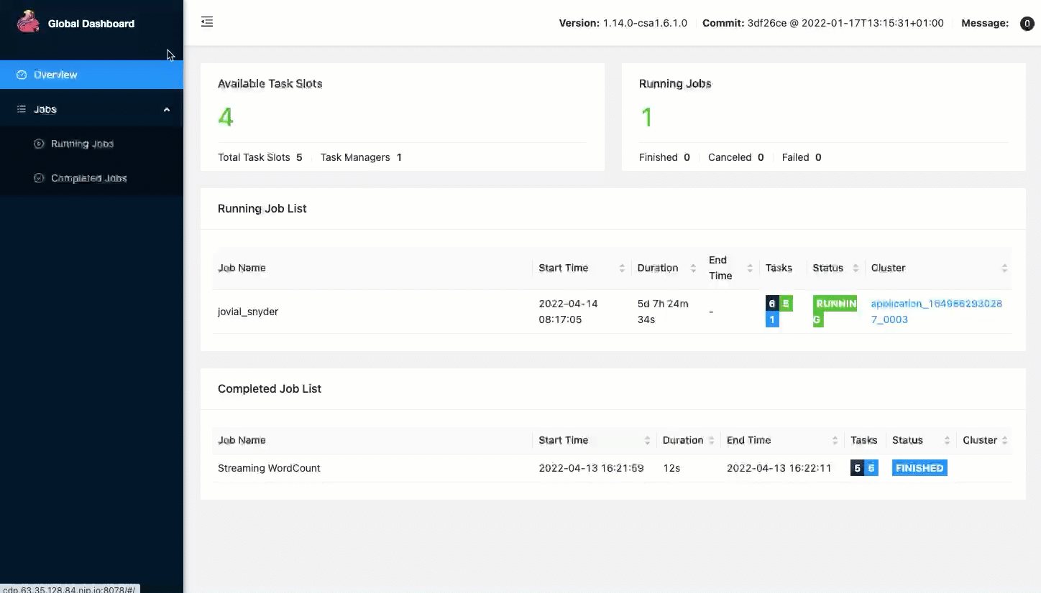
Flink
Link

Slide 11
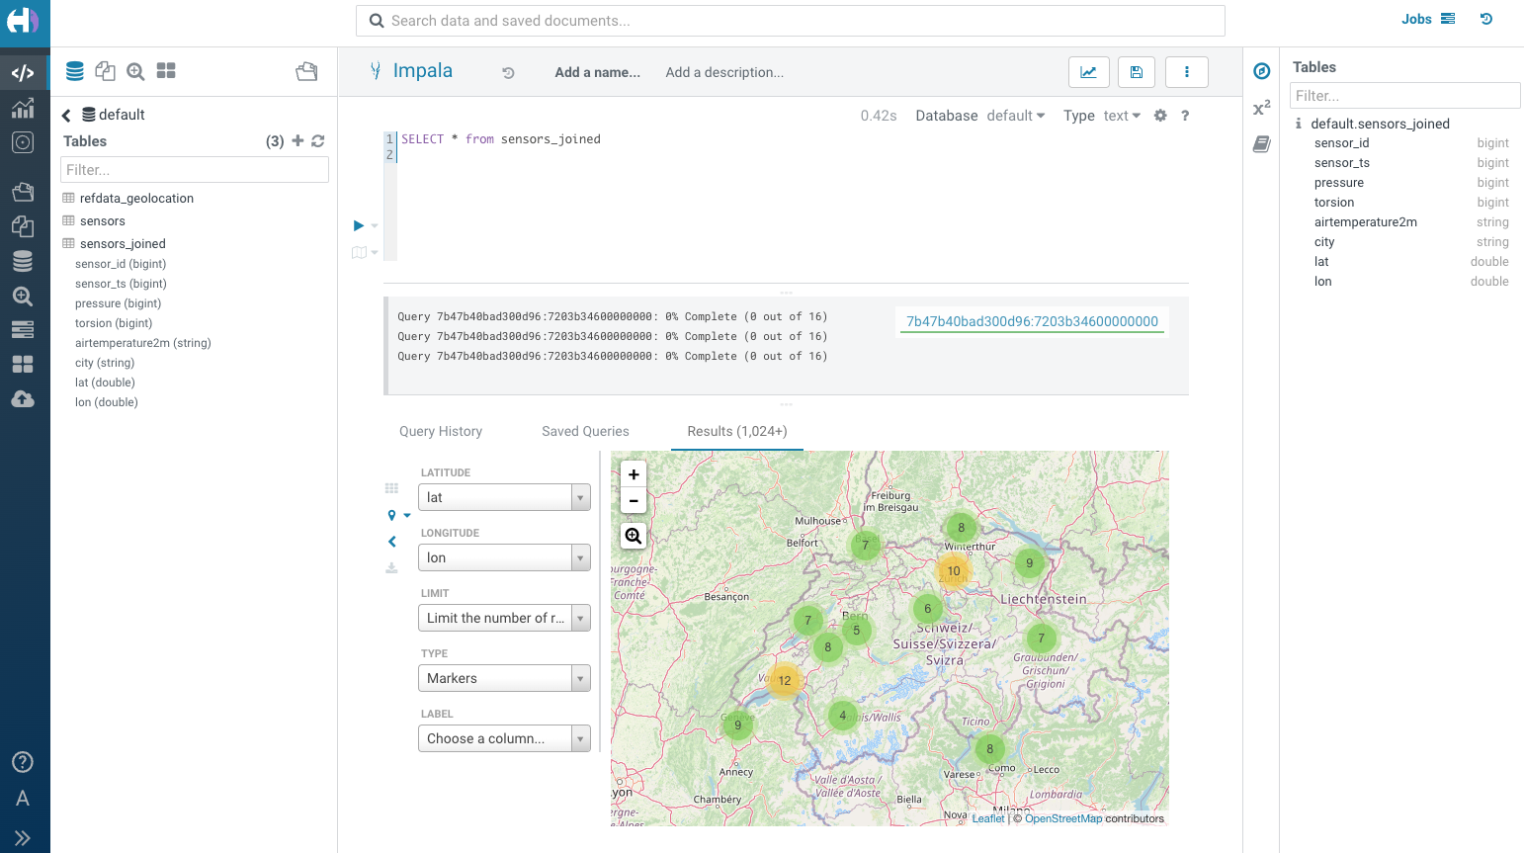

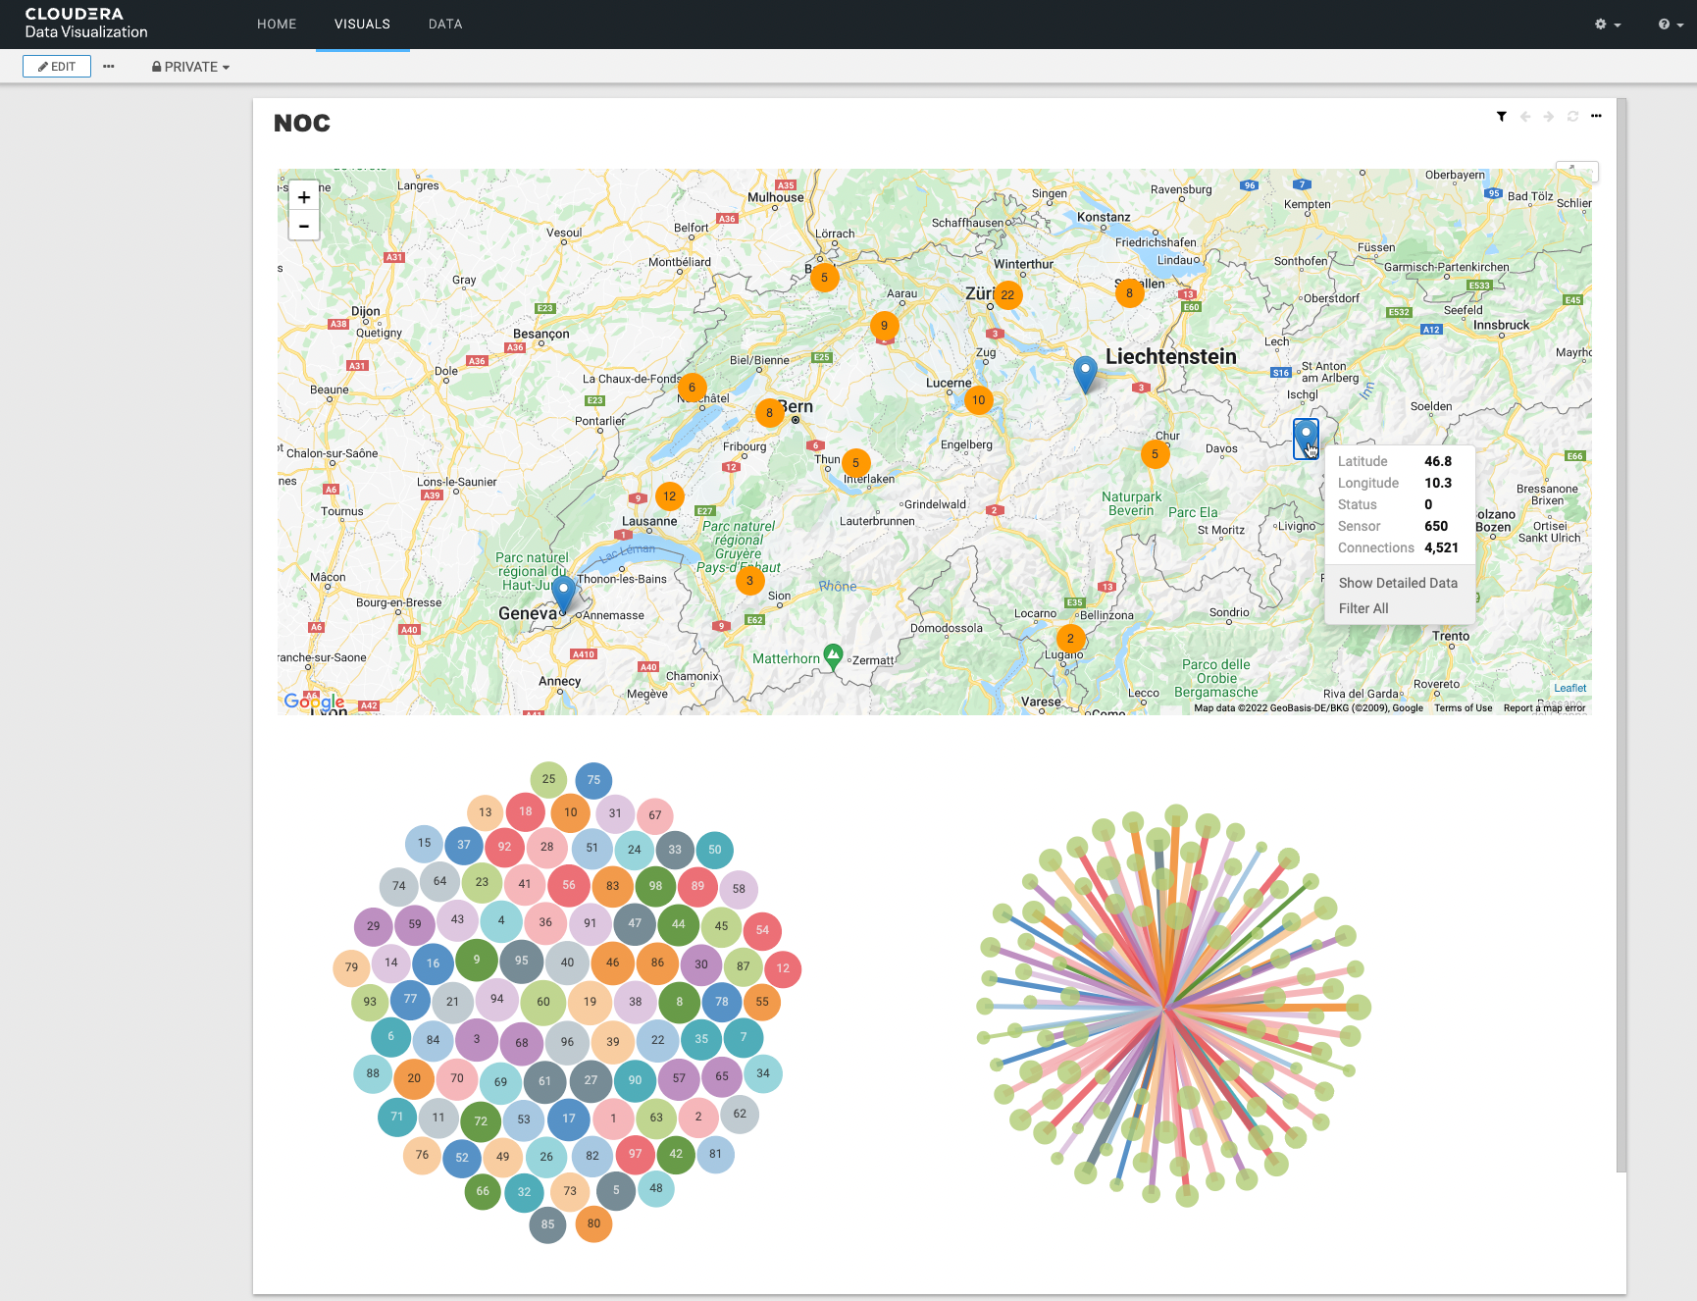
Report
Report
03
DATA WAREHOUSE

Slide 12
Impala + Kudu
Link

Slide 13
Data Visualization and Beyond
Link

Slide 14
SQL Stream Builder
Continuous SQL allows for processing data using simple grammar.
Process data to traditional database. Most customers start here.
Low velocity batch data in Kudu/Hive/etc.
Continuous processing of data streams using SQL (via Flink)
Process data back to kafka, can be reprocessed if need be
Continuous SQL
Sink
Process to files for complete history or compliance
High velocity streaming data in kafka
Send data to webhook sink for microservices or external services

